Slide 1

Notes:
i want different first page
can you paste it i give you picture of it

Slide 2

Certification by WNS Cares Foundation
This certifies that Mr. Keshav Sharma successfully completed the project titled "Cyber Security Awareness Drive through WNS Cares Foundation."
He dedicated a minimum of 30 hours to this project, significantly contributing to:
Educating community members on crucial digital safety practices.
Improving awareness regarding cyber threats across various age groups.
Promoting responsible online behavior within the community.

Slide 3
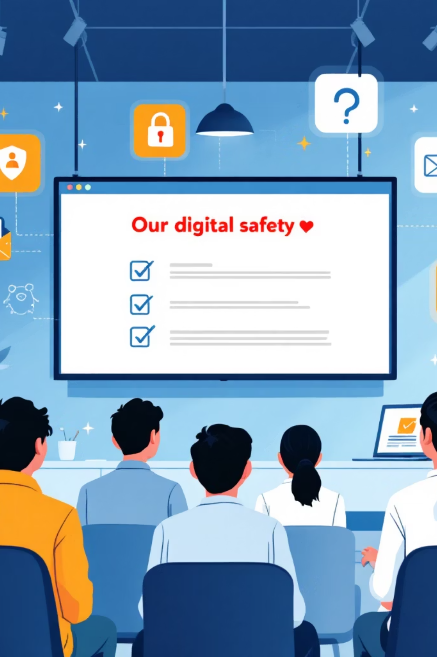
Introduction to Digital Safety
Cyber Security is vital for protecting individuals and organizations from these threats. This project facilitated an interactive session for students, focusing on safe and responsible technology use.
The objective was to bridge the gap between theoretical knowledge and practical awareness of common cyber threats and preventive measures through real-life case studies and hands-on activities.
The internet has become integral to our daily lives, connecting individuals, systems, and services globally. However, this connectivity brings significant risks such as hacking, phishing, identity theft, and data breaches.

Slide 4

Problem Identification: Vulnerable Digital Citizens
Problem
Many students extensively use the internet but lack awareness of cyber threats and safe online behaviors, making them susceptible to scams, phishing, identity theft, and privacy violations.
Cause
The primary cause is inadequate practical cybersecurity education in schools. Without proper training, students often use weak passwords, overshare personal information, and neglect digital hygiene, increasing their vulnerability to cybercrimes.

Slide 5

Key Objectives for Cyber Awareness
Empowerment
Threat Recognition
Provide students with crucial knowledge and practical skills for self-protection in the digital realm.
Raise awareness about prevalent cyber threats like phishing, malware, identity theft, and social engineering, along with effective prevention strategies.
Safe Practices
Hands-on Learning
Emphasize strong passwords, two-factor authentication, secure browsing, and responsible social media use.
Utilize interactive demonstrations to enhance engagement and retention of cyber safety concepts.

Slide 6
Steps Taken: Building a Secure Digital Foundation
01
02
Session Planning
Cyber Security Overview
Developed a detailed lesson plan with theory, examples, and interactive activities, gathering real-world case studies and tools.
Clarified cybersecurity's definition, significance, and function, highlighting global and local cybercrime statistics.
03
04
Cyber Threat Categories
Activity Demonstration
Reviewed prevalent threats like phishing, malware, and social engineering, illustrating with actual examples.
Showcased how cybercriminals use fake login pages and demonstrated strong password creation and password managers.
05
06
Internet Safety Practices
Case Studies & Interaction
Instructed on website security verification, social media privacy settings, and avoiding suspicious links.
Presented cybercrime cases, facilitated discussions, conducted phishing simulations, and demonstrated antivirus software.

Slide 7
Impact & Outcomes: Enhanced Digital Confidence
Heightened Awareness
Increased Confidence
Students gained a deeper understanding of cyber threats and vulnerabilities.
Participants felt more secure in identifying and responding to suspicious online activities.
Proactive Measures
Inspiring Future Leaders
Adoption of stronger passwords, two-factor authentication, and cautious online interactions.
Many students expressed interest in pursuing advanced cybersecurity skills and careers.
The hands-on demonstrations were particularly impactful, making complex theoretical concepts relatable and memorable for all participants.

Slide 8

Societal Problems & Project Effectiveness
Identified Societal Problems
Significant lack of public understanding regarding cyber threats.
Escalating frequency of cybercrime incidents targeting young internet users.
Effectiveness of the Project
The session successfully enhanced students' understanding of online safety. Feedback showed increased confidence in identifying suspicious activities, adopting stronger passwords, and enabling two-factor authentication.
The project sparked long-term curiosity, with some students expressing interest in advanced cybersecurity skills, effectively meeting its objective to educate and motivate.

Slide 9

Conclusion: Towards a Digitally Literate Society
The Cyber Security awareness session was a crucial step in empowering students with the necessary knowledge to navigate the digital realm safely. The growing dependence on technology has turned online safety into not just an individual responsibility but a collective necessity.
Engaging Strategies: Interactive teaching linked theoretical principles to real-world scenarios effectively.
Shifting Understanding: Participants' feedback showed a significant shift in their perception of online safety.
Collective Necessity: Online safety is a shared responsibility in an increasingly digital world.
Future Impact: Further workshops can foster a digitally literate society, resilient against evolving threats.
Continuous Education: Emphasizes the critical need for cybersecurity education in academic curricula.
By promoting awareness, we can collectively work towards establishing a safer and more secure online environment for all.

